Slide 1
Comprehensive Digital Marketing Project work

Slide 2

Part 1: Brand study, Competitor Analysis & Buyer’s/Audience’s Persona
COMPANY/TOPIC for project: YES BANK
Research Brand Identity: Study the brand's mission, values, vision, and unique selling propositions (USPs).
Brand Colours :
Red, Blue
Logo :
Mission/Values:
To establish a high-quality, customer-centric, service-driven, private Indian Bank catering to the 'Future Businesses of India. "To be the 'Professionally Managed Best Bank' in India by providing superior, proactive banking services and innovative financial solutions, globally."
USP:
operates its Investment banking, Merchant banking & Brokerage businesses through YES SECURITIES, a wholly owned subsidiary of the Bank.

Slide 3
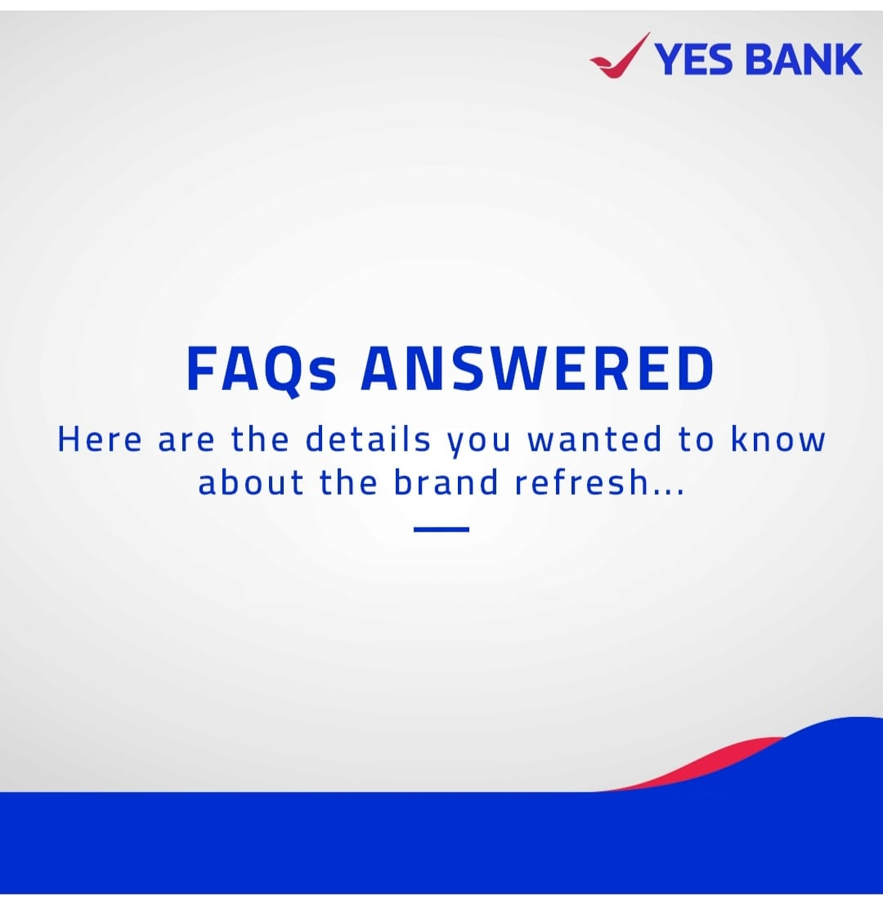

Part 1: Brand study, Competitor Analysis & Buyer’s/Audience’s Persona
COMPANY/TOPIC for project: YES BANK
Analyze Brand Messaging: Informative FAQ sessions, User generated content, Creativity
https://www.instagram.com/p/CtrLKelo6Js/?igshid=MzRlODBiNWFlZA==
https://www.instagram.com/p/CuBqktRvfDG/?igshid=MzRlODBiNWFlZA==
Examine the brand's tagline:
'Life Ko Banao Rich'

Slide 4
Part 1: Brand study, Competitor Analysis & Buyer’s/Audience’s Persona
Competitor Analysis: Select three competitors operating in the same industry or niche as the chosen brand, examine their USPs and online communication.
Competitor 1:RBL BANK
https://www.rblbank.com/
USP:
Innovative Products and Services, Agile and Customer-Focused, Digital Initiatives.
Online Communication: Provided toll free number and chat box
Competitor 2: ICICI BANK
https://www.icicibank.com/
USP:
Extensive Network, Digital Banking, Customer Service.
Online Communication: Provided offical website URL and chat box
Competitor 3:BANKOFBARODA
USP:
https://www.bankofbaroda.in/
Global Presence, Diverse Range of Services, Customer-Centric Approach
Online communication: provided contact number and email id

Slide 5
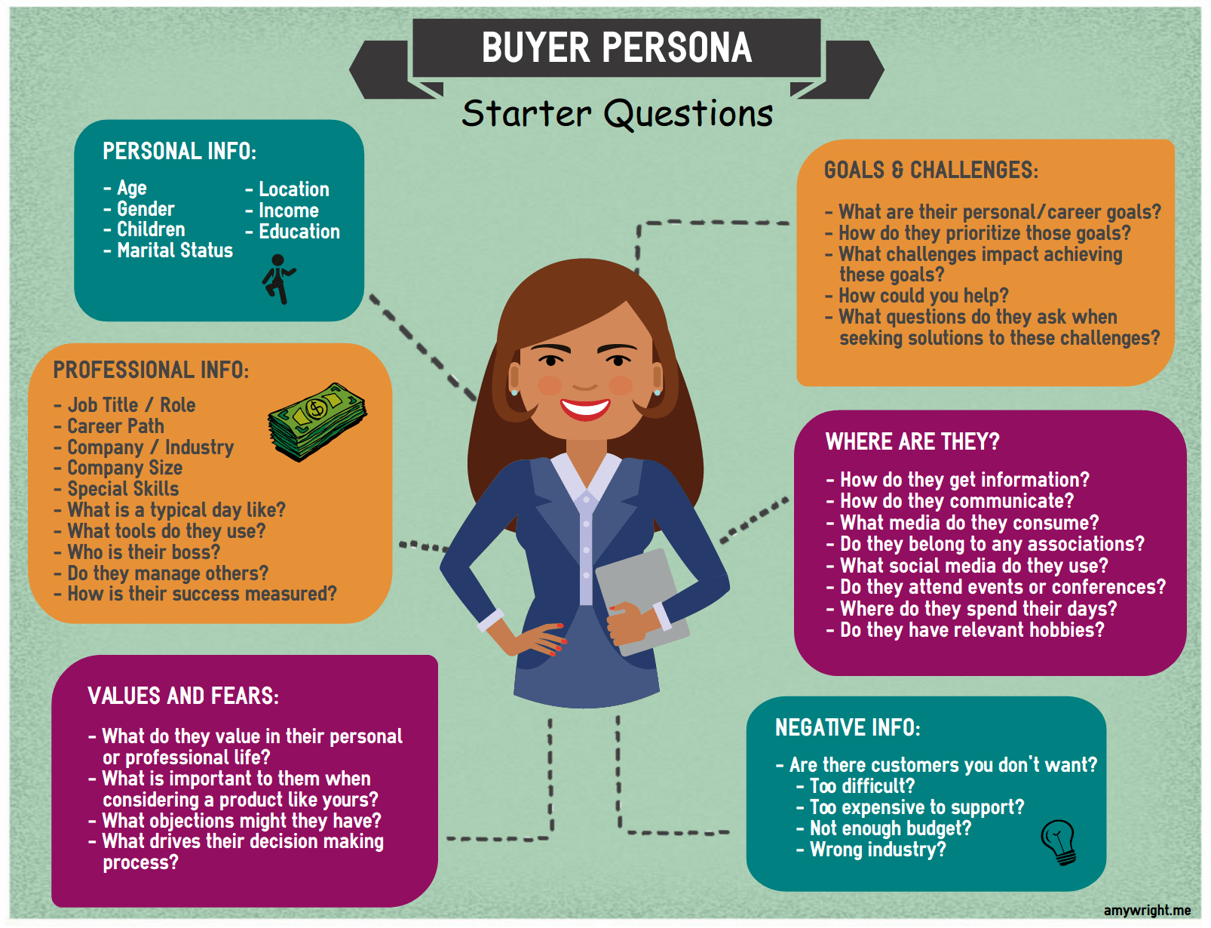
Part 1: Brand study, Competitor Analysis & Buyer’s/Audience’s Persona
Buyer's/Audience's Persona: Clearly define the target audience for the chosen brand. Consider demographics, psychographics, behaviors, and interests.
AGE RANGE: Above 10 years (includes minor account),It also providing
YES BANK Young tar account between the age of 1-18years.
GENDER: Any Gender
CHILDERN : YES
MARITAL STATUS: Married/Un married
LOCATION: Metro Cities, Tier 2 & Tier 3 Cities
INCOME: 26,624.08
EDUCATION: Educated/NonEducated
WHAT DO THEY VALUE IN THEIR PROFESSIONAL LIFE? – Social Status, May lead better life
WHAT IS IMPORTANT TO THEM WHEN CONSIDERING PRODUCTS?- Rate of interest ,Handling Charges ,Hidden Charges ,Comparisions,Card Benetifits
WHAT OBJECTIONS MIGHT THEY HAVE?-Hidden Chareges, Heavy interests
HOW DO THEY GET THEIR INFORMATION?-SMS,Phone Calls,Internet Banking Notifications Ads on websites
HOW DO THEY COMMUNICATE?- Whatsapp,Chat bot, Instagram,E-Mail, SMS,Toll free numbers etc

Slide 6
Part 2: SEO & Keyword Research
SEO Audit: Do an SEO audit of the brands website
Keyword Research: Define Research Objectives, Brainstorm Seed Keywords, Utilize Keyword Research Tools (SEMrush or Moz Keyword Explorer),Analyze Competitor Keywords, Long-tail Keyword Exploration (specific, longer phrases) that align with the research objectives and have lower competition but higher conversion potential.
On page Optimization: Meta Tag optimization & content optimization
Reflect on the process of conducting keyword research and the SEO recommendations provided.
Document the challenges faced during the research and analysis phase, as well as the key insights gained from the keyword research process.

Slide 7
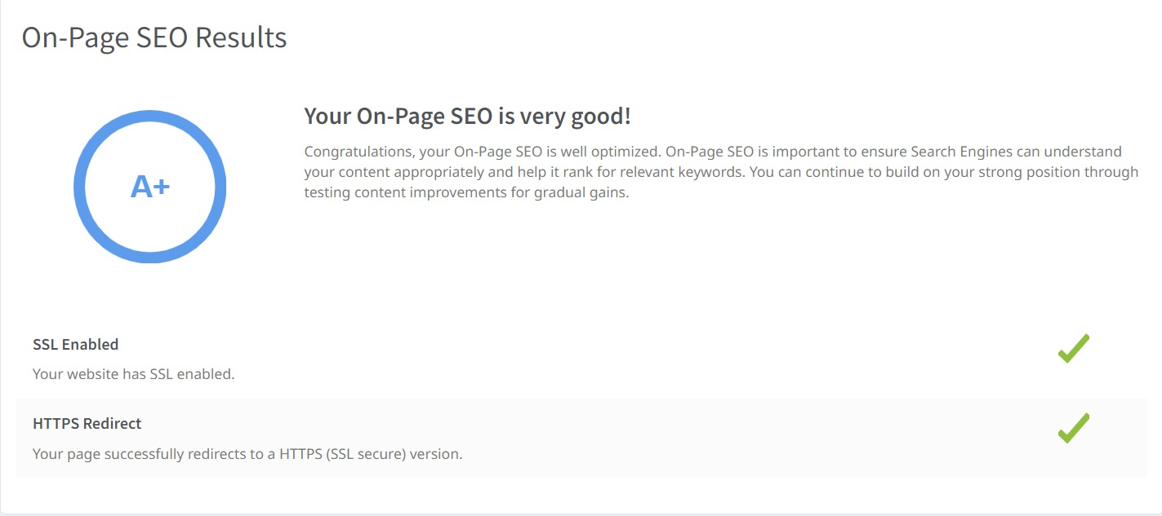

Slide 8
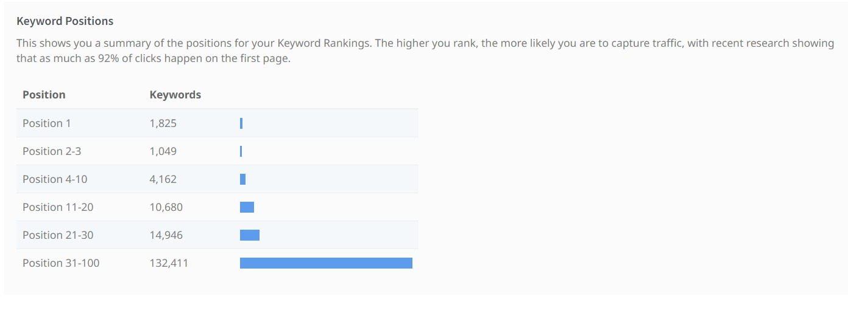

Slide 9
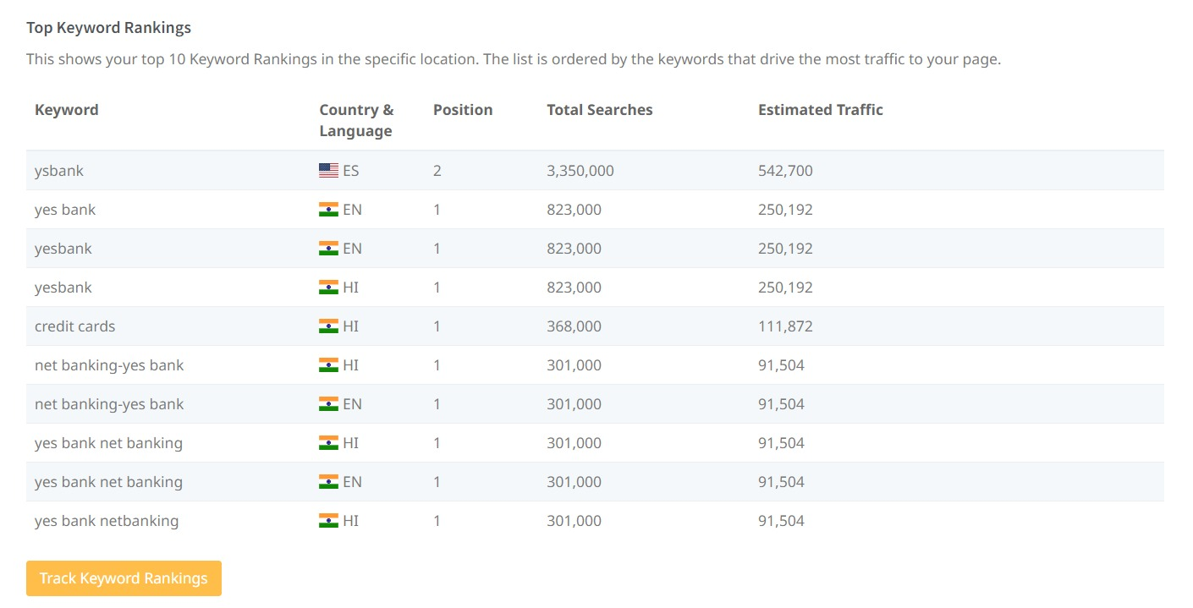

Slide 10
LOAN RATES
Keyword | Avg. monthly searches | Competition
car loan rates | 5000 | Low
home loan rates | 5000 | Low
personal loan rates | 5000 | Low
Meta Title
Check the lowest loan rates of Car Loan, Home Loan, Personal loan |  |  | 63
Meta Description
Apply for lowest rates of Car loan, Home loan, Personal loan at YES Bank |  |  | 74
LOANS
Keyword | Avg. monthly searches | Competition
car loan | 50000 | Low
educational loan | 50000 | Low
mudra loan | 500000 | Low
Meta Title
FInd the best loans like Car ,Educational & Mudra loans at YES Bank |  |  | 69
Meta Description
Apply now for the Feautured loans like Car loan, Educational loan, Mudra loan at YES Bank |  |  | 91

Slide 11
CREDIT CARDS
Keyword | Avg. monthly searches | Competition
postpaid credit card | 500 | Medium
fixed deposit credit card | 5000 | Medium
fuel credit card | 5000 | Medium
Meta Title
We introducing new postpaid,fixed deposit,fuel Credit cards in our Bank |  |  | 71
Meta Description
Enjoy the Benefits of new Featured Credit cards like Postpaid , Fixed deposit, Fuel credit cards in our Bank |  |  |  |  |  | 108
CHARGES
Keyword | Avg. monthly searches | Competition
credit card charges | 5000 | Low
debit card transaction charges | 500 | Low
credit card swipe charges | 5000 | Low
Meta Title
Check the charges of Credit card,debit card & credit card swipe charges |  |  | 71
Meta Description
Apply Feautured Loans like Home loan, Mudra Loan, Student Loan from YES BANK |  |  | 72

Slide 12
EMI
Keyword | Avg. monthly searches | Competition
gold emi online | 50 | High
gold emi scheme | 500 | Low
gold loan emi | 500 | Medium
Meta Title
Explore new options like Gold Emi online , Gold Emi scheme , Gold loan Emi |  |  |  | 70
Meta Description
Check the interesting gold Emi online, gold Emi Scheme , Gold loan Emi at YES Bank |  |  |  | 82

Slide 13
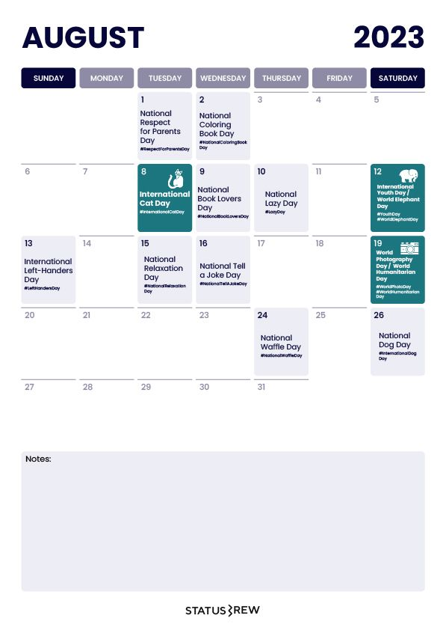
Part 3: Content Ideas and Marketing Strategies
Content Idea Generation & Strategy: Create a content calendar for the remaining month of July by brainstorming content themes, exploring various formats like blog posts, videos, infographics, podcasts, and interactive quizzes, and scheduling publication dates mainly on Facebook & Instagram.
And include the strategy, aim and the idea behind these posts and story
Content Calendar Example (Try creating a table for the month of July)

Slide 14
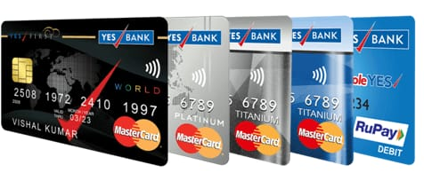
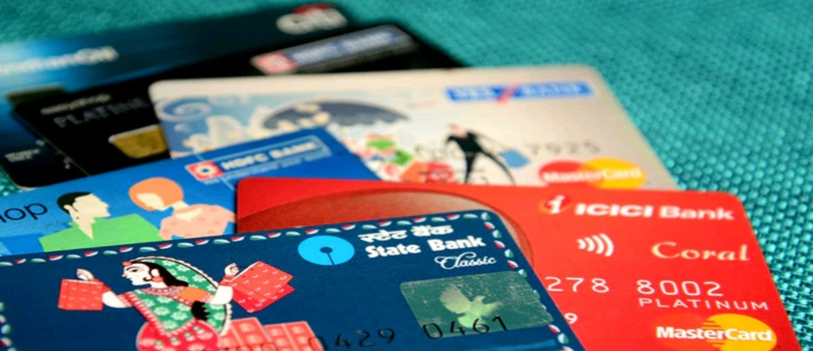
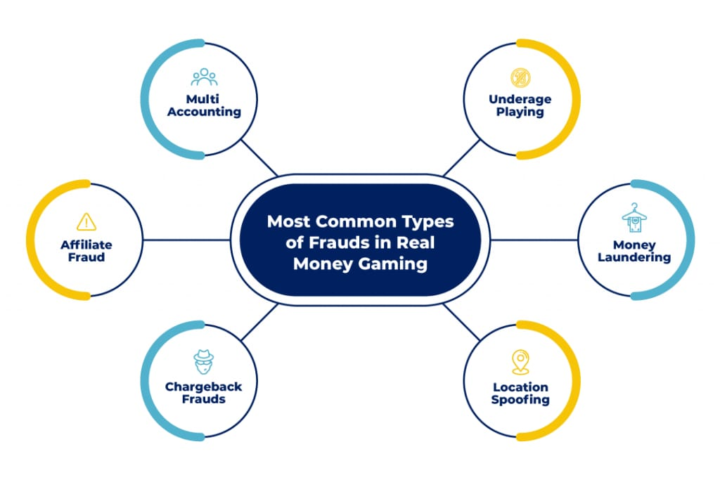
Part 3: Content Ideas and Marketing Strategies
Reflect on the content ideas and marketing strategies process, discussing the challenges encountered and lessons learned.
Blog article
Date: 21/August/2023
To create awareness on YES BANK online services
Our bank launches for customers apply debit card at online
Date: 22/August/ 2023
To promote different types & updates of debit cards
Debit card & its Different types in YES BANK.
In this video I Visualised in a very brief manner
about different types of cards & its benefits.
Date: 23/August /2023
Awareness about frauds on digital transactions
To create a meme frauds on digital marketing

Slide 15
Creating content ideas and devising effective marketing strategies is a dynamic process that involves continuous learning and adaptation. Throughout this journey, several challenges and valuable lessons can be encountered. 1.Understanding the Audience: One of the primary challenges is comprehending the target audience's preferences, needs, and pain points. 2. Generating Unique Ideas: Coming up with fresh and innovative content ideas can be difficult, especially in saturated markets. 3. Consistency and Quality: Maintaining a consistent flow of high-quality content can be demanding. Setting up an editorial calendar and adhering to a content creation schedule helps in maintaining quality and meeting deadlines. 4. Content Promotion: Even the best content may not gain traction without proper promotion. Crafting effective marketing strategies to reach the target audience across various channels is crucial for success. 5. Collaboration: Collaborating with influencers or other brands can amplify the reach of content and strengthen marketing efforts. The content ideas and marketing strategies process is an iterative and learning-oriented journey

Slide 16
Part 4: Content Creation and Curation (Post creations, Designs/Video Editing, Ad Campaigns over Social Media and Email Ideation and Creation)
Post Creation:
Select Content Categories: Identify three different content formats relevant to the chosen topic or industry. Research and Brainstorm: Research trending topics, industry news, or audience interests within each category. Brainstorm ideas for social media posts that align with each category. Do note that 1 content format has to be video and additionally 3 stories/status are to be created.
Format 1: Blog article
Format 2: Video
Format 3 : Creative

Slide 17
Part 4: Content Creation and Curation (Post creations, Designs/Video Editing, Ad Campaigns over Social Media and Email Ideation and Creation)
Format 1: Blog article
Aim: To create awareness on YES BANK online services
Date: 21/August/2023
Idea: Our bank launches for customers apply debit card at online
Topic:
A Step-by-Step Guide to YES BANK Debit Card Application Process Online
Step 1 : Visit the YES Bank Website: Open your web browser and go to the official website of YES Bank (www.yesbank.in).
Step 2 : Navigate to "Personal Banking“: On the YES Bank homepage, you should find an option like "Personal Banking" or "Individuals." Click on that to proceed.
Step 3 : Select "Debit Cards": Look for a section related to "Debit Cards" or "Cards" and click on it to explore the various debit card options offered by YES Bank.

Slide 18
Step 4 : View Available Debit Cards: YES Bank typically provides different types of debit cards with varying features and benefits. Review the available options to find the one that best suits your requirements.
Step 5 : Choose the Debit Card: Once you've decided on a specific debit card, click on "Apply Now" or a similar button to start the application process
Step 6 : Fill out the Application Form: You'll be directed to an online application form. Provide the necessary details, which may include your name, contact information, address, date of birth, PAN number, etc.
Step 7 : Review and Submit: Double-check all the information you've provided and verify that the uploaded documents are clear and legible. After ensuring everything is correct, submit the application form.
Step 8 : Wait for Verification: After submitting your application, YES Bank will review your details and documents. This process might take some time, and the bank might contact you for further information if needed.
Step 9 : Debit Card Delivery: If your application is approved, YES Bank will issue the debit card and have it delivered to the address you provided during the application process. The delivery time may vary depending on your location
.

Slide 19

Part 4: Content Creation and Curation (Post creations, Designs/Video Editing, Ad Campaigns over Social Media and Email Ideation and Creation)
Format 2: Video
Aim: To promote different types & updates of debit cards
Date: 22/August/ 2023
Idea: Debit card & its Different types in YES BANK
Topic : In this video I visualised in a very brief manner about different types of cards & its benifits

Slide 20

Part 4: Content Creation and Curation (Post creations, Designs/Video Editing, Ad Campaigns over Social Media and Email Ideation and Creation)
Format 3: Creative
Aim: Awareness about frauds on digital transactions
Date: 23/August /2023
Idea: To create a meme frauds on digital marketing
Topic: Meme

Slide 21
Part 4: Content Creation and Curation (Post creations, Designs/Video Editing, Ad Campaigns over Social Media and Email Ideation and Creation)
Instagram Story
Utilize the Stories feature on Instagram for three consecutive days. Share behind-the-scenes glimpses, polls, quizzes, or sneak peeks etc to encourage audience participation. Once uploaded use the story highlight feature on Instagram and save the 3 story with an appropriate name for each.
Note:
Once done monitor the performance of the posts and Stories using the insight tool and analyze the engagement metrics (likes, comments, shares, impressions, etc.). Based on the analysis, mention the strategies and areas for improvement.

Slide 22
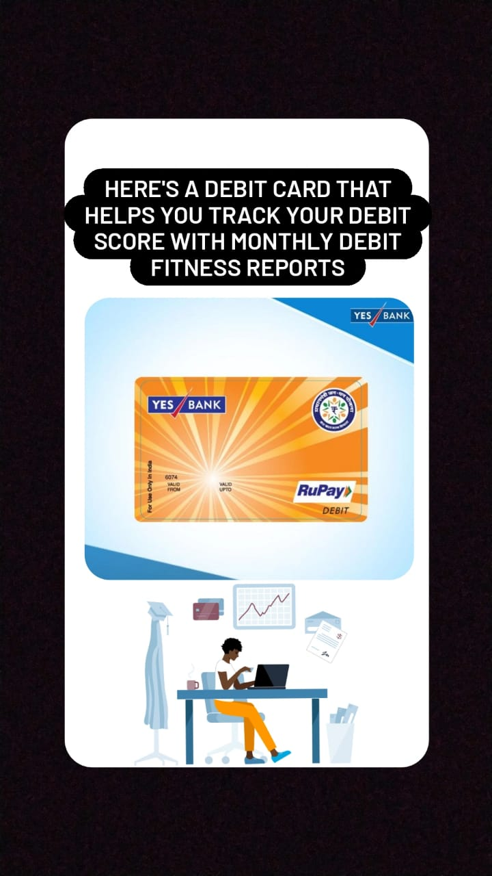
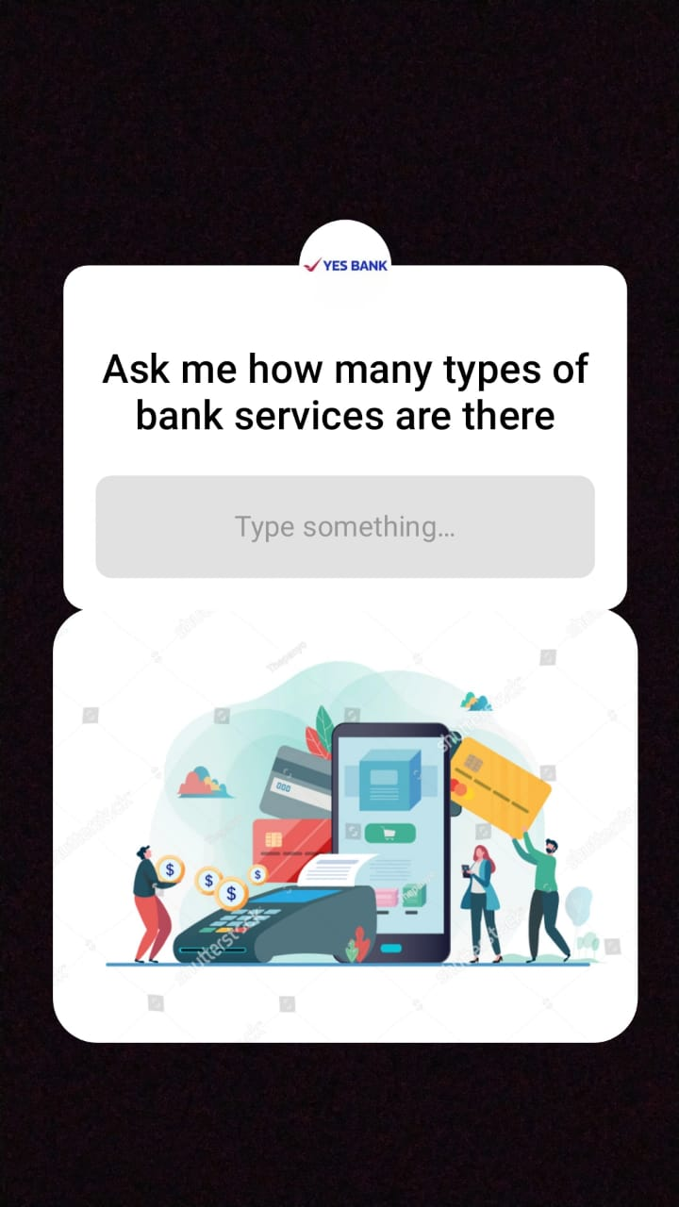
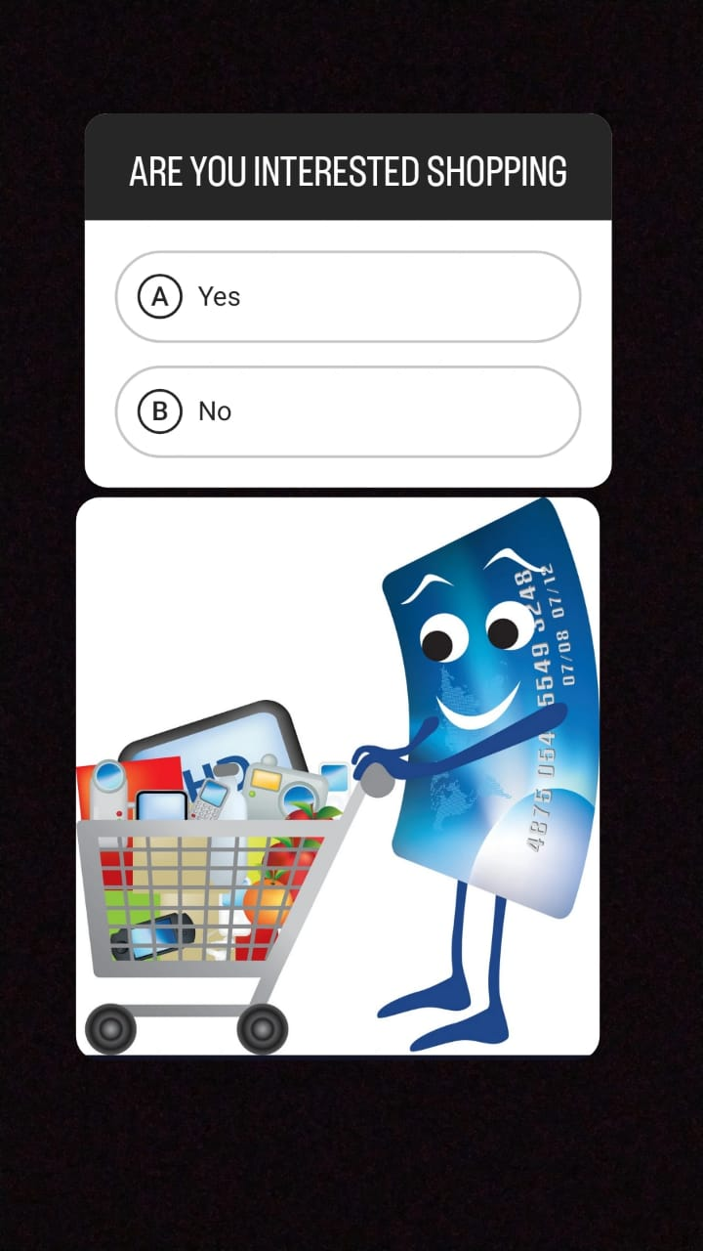
Part 4: Content Creation and Curation (Post creations, Designs/Video Editing, Ad Campaigns over Social Media and Email Ideation and Creation)
Instagram Story

Slide 23
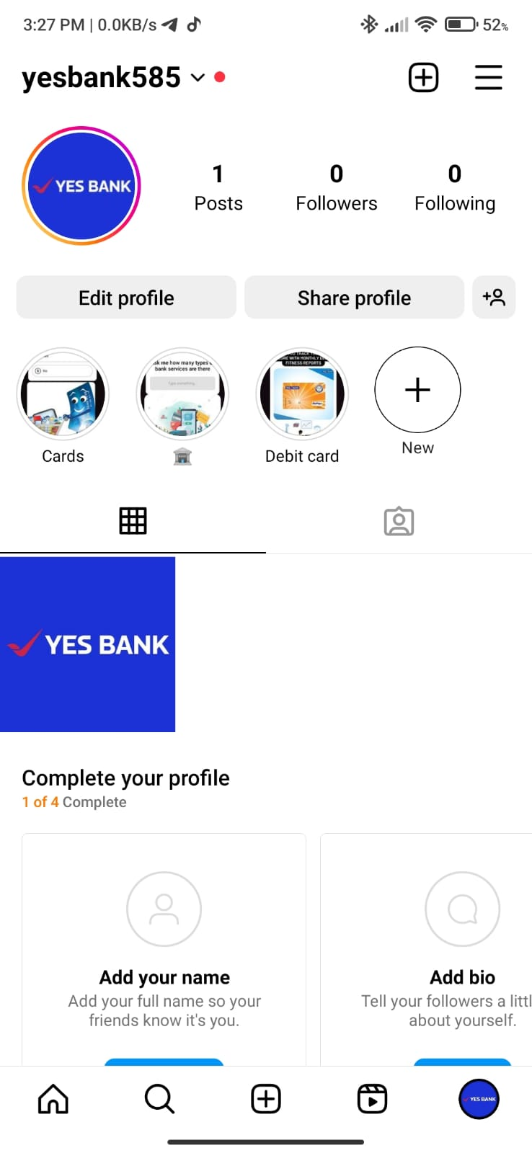

Slide 24
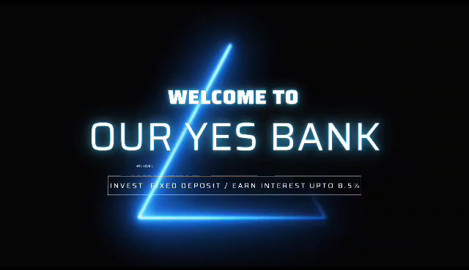
Part 4: Content Creation and Curation (Post creations, Designs/Video Editing, Ad Campaigns over Social Media and Email Ideation and Creation)
Designs/Video Editing
Design Tools Familiarization (use Canva for creating visually appealing graphics)
Video Creation: Utilize VN or any video editor of your choice to create videos related to the chosen topic.

Slide 25
Part 4: Content Creation and Curation (Post creations, Designs/Video Editing, Ad Campaigns over Social Media and Email Ideation and Creation)
Social Media Ad Campaigns
Ad Campaigns over Social Media:
Come up with 3 ad campaigns each covering one of the mentioned goals: brand awareness, driving website traffic, or generating leads

Slide 26
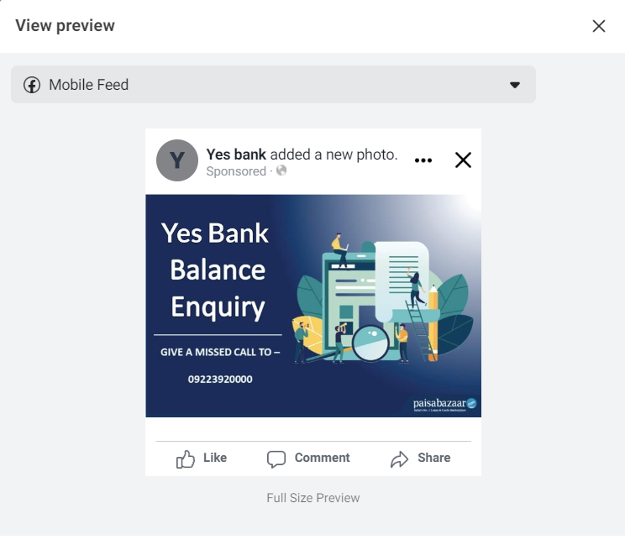
Brand awareness Campaigns :
Targeting- Location: India, All Genders
Interests: Axis Bank, HDFC Bank, Yes Bank, IndusInd Bank

Slide 27
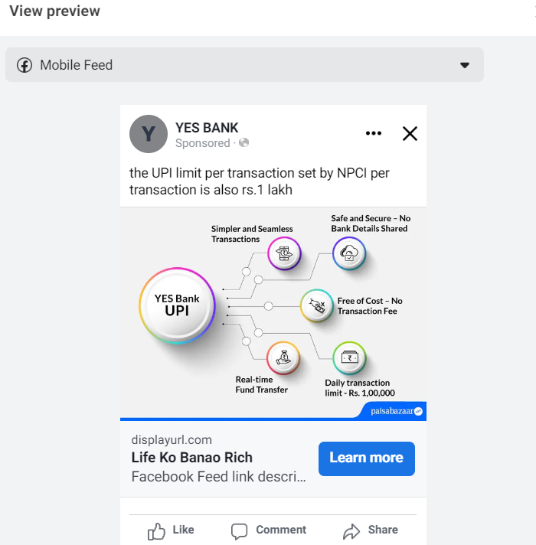
Driving website traffic:
Targeting- Location: India, All Genders
Interests: Axis Bank, HDFC Bank, Yes Bank, IndusInd Bank

Slide 28
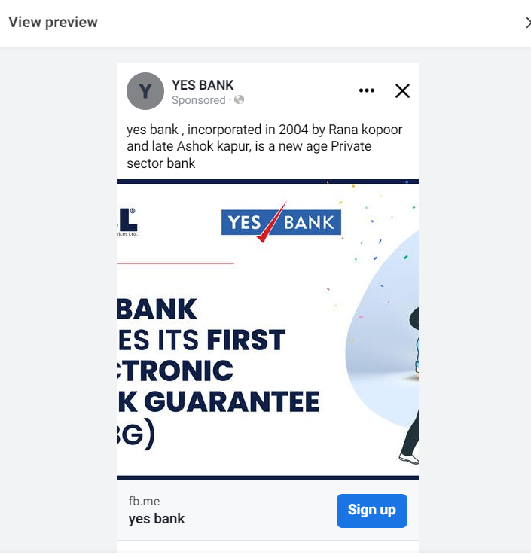
Generating Leads :
Targeting- Location: India, All Genders
Interests: Axis Bank, HDFC Bank, Yes Bank, IndusInd Bank

Slide 29
Part 4: Content Creation and Curation (Post creations, Designs/Video Editing, Ad Campaigns over Social Media and Email Ideation and Creation)
For every campaign clearly define:
Advertising Goals: increasing brand awareness, driving website traffic, or generating leads.
Audience Targeting: Define the target audience for the ad campaigns based on demographics, interests, and behavior.
Ad Creation: Create visually appealing ad creatives, compelling ad copy and relevant call-to-action.

Slide 30
Part 4: Content Creation and Curation (Post creations, Designs/Video Editing, Ad Campaigns over Social Media and Email Ideation and Creation)
Email Ad Campaigns
Ad Campaigns for email marketing:
Come up with 2 email ad campaigns with the mentioned goals: brand awareness & generating leads

Slide 31
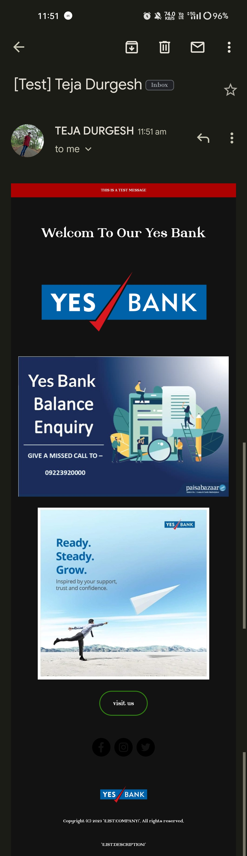
Email Ad Campaign 1 - Brand Awareness
(insert emailer image)

Slide 32
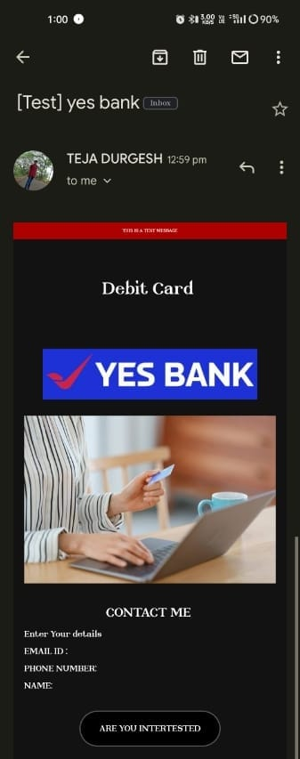
Email Ad Campaign 2 - Lead Generation
(insert emailer image)

Slide 33
Part 4: Content Creation and Curation (Post creations, Designs/Video Editing, Ad Campaigns over Social Media and Email Ideation and Creation)
Reflect on the content creation and curation process, discussing the challenges faced and lessons learned.
1. Consistency is Key: Maintaining a consistent tone, style, and frequency of content across platforms helps reinforce brand identity and improves audience recall.
2.Visual Appeal: Eye-catching visuals, well-designed graphics, and professionally edited videos can significantly enhance the impact of content and ad campaigns.
3. A/B Testing: Regularly conducting A/B + tests for ad campaigns and email subject lines allows for data-driven optimization and better results.
4.Know our Audience: Understanding the target audience's interests, pain points, and preferences is fundamental in creating relevant and engaging content.
5. Engage with the Audience: Responding to comments, messages, and feedback from the audience fosters a sense of community and builds trust.
6. Long-Term Approach: Content creation and marketing are not one-time endeavors. A long-term, strategic approach is necessary to build brand awareness and achieve sustainable growth.
In conclusion, content creation and curation, along with thoughtful design, video editing, and well-executed ad campaigns, play a pivotal role in a successful marketing strategy. By understanding the challenges and incorporating the lessons learned, businesses can create compelling content that resonates with their target audience and drives results

